Slide 1
Deployment Options
Class 12

Slide 2
Agenda
Project 2

Slide 3
Deploying Apps

Slide 4
How shinyapps.io works
Build
Deploy
Host
We’ve been doing this with every app
What shinyapps.io does

Slide 5
Hosting
What’s that?

Slide 6
Locally Hosting
The main difference is HOW things are done.
Build: Still done the same way, writing your app and testing it on your local machine
Deploy: Moving the necessary files to your server
Host: Get your server up and running

Slide 7
What do you need to host?
You need a server that can host the applications
What’s a server?
Servers are computers that don’t have screens
They are how the internet works
Check with your IT people, you may already have server space at your organization
Cloud hosting is also an option

Slide 8
Linux
You can also use windows or mac servers, but Linux is the standard

Slide 9
Does that mean I should learn Linux?
Yup!
But not that much.
Typically the installation walkthroughs for products have most of what you need.

Slide 10
Shiny server
Free/Community Edition

Slide 12
Moving Apps to the folder
Use terminal/command prompt and ssh
A nice friendly UI that passes the commands for you
WinSCP: For Windows
Cyberduck: For Mac Users
Other things

Slide 13
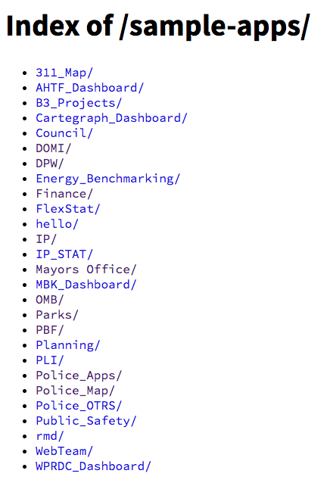
The apps are stored in folders

Slide 14
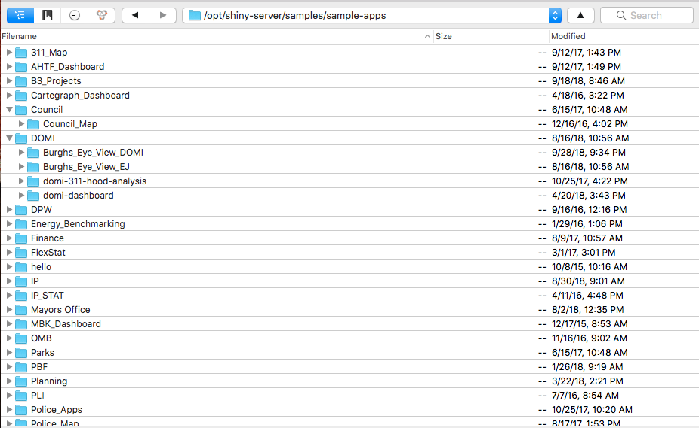
What it looks like in Cyberduck

Slide 15
Multiple users of the same App are put in a queue each time a set of R code has to be performed

Slide 16
Pro & Cons of Shiny Server Community
Pros:
Free (so long as you have server space)
No concurrent user limit
Cons:
No authentication method
No performance balancing
No insight into who is using an application when
Self administered server

Slide 17
Shiny server Pro

Slide 18
Pro lets you give each user their own dedicating process, increasing performance.
However there is a limit to how many users you can have on Pro.

Slide 21
Pro & Cons of Shiny Server Pro
Pros:
Admin console
Dedicated R processes for each application
Support (only for maintaining the server not R code)
User authentication
Cons:
Costs money
You have to pay MORE money for MORE users

Slide 22
shinyproxy
https://www.shinyproxy.io/

Slide 23
Okay, let’s say I don’t want to shell out the money for Pro
The open source community has your back!
ShinyProxy has a lot of the things Shiny Server Pro provides
But it uses Docker!
Docker is a tool designed to make it easier to create, deploy, and run applications by using containers. Containers allow a developer to package up an application with all of the parts it needs, such as libraries and other dependencies, and ship it all out as one package. - https://opensource.com/resources/what-docker

Slide 24
How are apps stored on

Slide 25
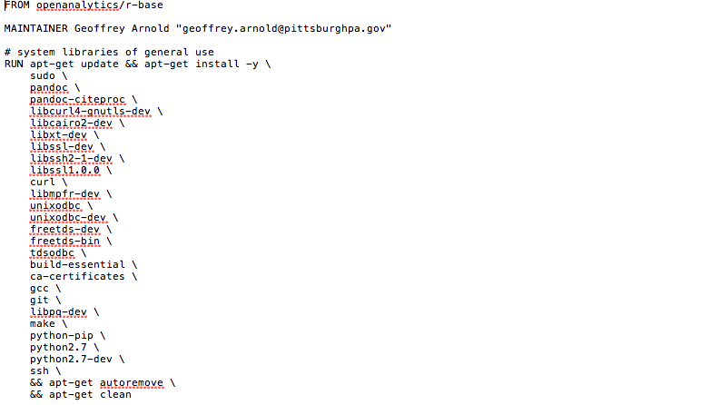
Docker files?
List of bash commands that build a “container”

Slide 26
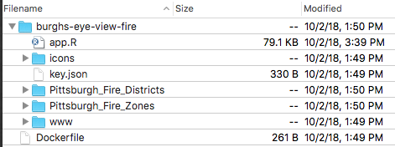
Deploying
Put your app folder somewhere inside a folder on your server
Have the docker file in this folder as well.
Run the command: sudo docker build -t name-of-your-app-here .

Slide 27
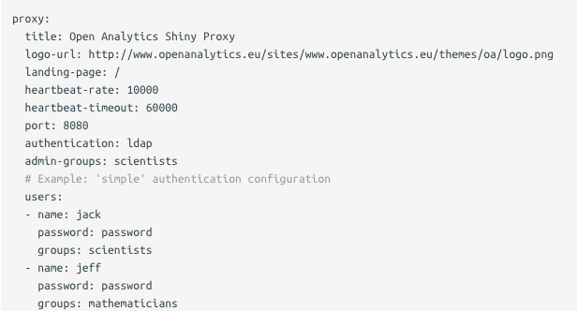
Configuration

Slide 28
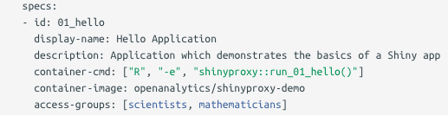
Configuration cont.

Slide 29
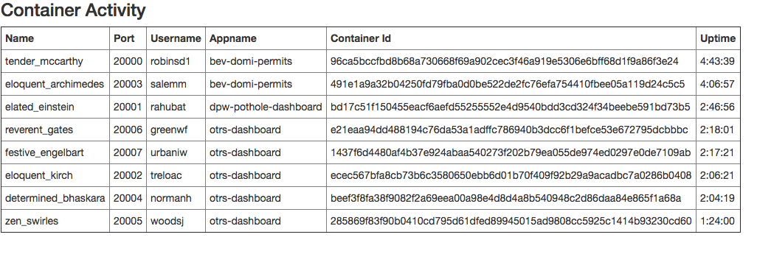
Admin Console

Slide 30
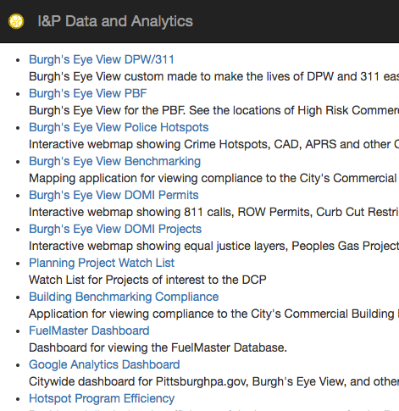
Optional
See shinyproxy in action

Slide 31
Project 2

Slide 32
Project 2: Due 10/19/18
To bring the entire course together students will create an interactive map that includes one (1) interactive map, one (1) datatable, and one (2) interactive charts or graphs. All data should be pulled from a web API’s. The app should have at least two different types of layers (points/markers, lines, heatmap or polygons) and at least four (4) input commands and the ability for the user to download the raw data they are viewing.
Applications should be deployed and working on shinyapps.io.

Slide 33
Next Class
Putting Users First: Human-Centered Approaches to Digital Product Design
Guest Lecturer: Robert Burack

